Slide 1
5. Social Information Filtering

Slide 2
Contents
Social Information Filtering - Social Sharing and filtering
Automated Recommendation systems
Traditional Vs Social Recommendation Systems
Understanding Social Media and Business Alignment
Social Media KPI
Formulating a Social Media Strategy, Managing Social Media Risks

Slide 3
Social Information Filtering
Social information filtering is a process for organizing and filtering information based on social connections and relationships.
It can involve the use of algorithms and/or human judgment to identify relevant information.
It is used in a variety of contexts, including online social networks, news aggregators, and recommendation systems.
It can be used to surface relevant content to users based on their social connections and interests.

Slide 4
Social Information Sharing
Social information sharing refers to the exchange of information, ideas, and content among individuals within a social network or community.
It can take place through various channels, such as online social media platforms, messaging apps, forums, or in-person conversations.
Social information sharing can facilitate the spread of information and ideas, and can help to build connections and relationships among individuals.
It can also have negative consequences, such as the spread of misinformation or the invasion of privacy.
The use of algorithms and other technologies can facilitate social information sharing by suggesting content to users or by helping to connect individuals with similar interests.

Slide 5
Automated Recommendation System
An automated recommendation system is a technology that uses algorithms to suggest content, products, or other items to users based on their interests and past behaviors.
Recommendation systems can be used in a variety of contexts, such as online retail, streaming services, and social media.
They rely on data about the user, such as their past actions, preferences, and demographic information, to make personalized recommendations.
Recommendation systems can improve the user experience by providing relevant and personalized recommendations.
However, they can also raise concerns about privacy and the potential for manipulation or bias in the recommendations.

Slide 6
Traditional Recommendation Systems
Traditional recommendation systems rely on human judgment and expertise to recommend items to users.
These systems can be used in a variety of contexts, such as bookstores, libraries, and music stores.
They may rely on personal recommendations from friends or trusted sources, or on reviews and ratings provided by other users.
Traditional recommendation systems may be less personalized than automated systems, but they can also be seen as more trustworthy and reliable.
They may be less efficient than automated systems, but they can also be more flexible and adaptable to the needs and preferences of individual users.

Slide 7
Case Study : Reddit Voting System
Reddit is a social news website that allows users to post links and vote on them.
The votes are used to rank articles and determine which ones appear on the front page.
The simple vote count method can be biased towards older articles, as they have more time to gather votes and stay highlighted longer.
Reddit uses a system that estimates the 95% confidence interval for the number of up votes a post will receive, in order to fairly compare articles regardless of age.
This system adjusts after every vote and takes into account the total number of votes a post has received.
Sorting options, such as "Best," "Top," "New," "Old," and "Controversial," are important to Reddit users in order to navigate and make sense of the vast amount of content on the website.

Slide 8
Case Study : Trust Based Movie Recommendation
FilmTrust is a movie recommendation system that uses social networks and trust to make recommendations.
Users can rate and review movies, view others' ratings and reviews, and make social connections with other users on the system.
When creating a social connection, users are asked to rate how much they trust the other person's opinion about movies on a scale from 1 to 10.
The system estimates trust in other people's opinions using a weighted average based on the trust ratings given by the user and their friends.
Trust values are used to adjust the average rating of a movie and give more weight to ratings from users who are trusted more by the user receiving the recommendation.
The system also takes the user's own ratings into account when making recommendations.

Slide 9
Exercise - Case Study
Choose a popular current issue of public debate (a bill under consideration, an election, or a political issue). Search Twitter for posts about that issue.
What opinions are you able to find? Summarize them.
Is one opinion dominating the others?
Do you find a lot of content repeated? Perhaps one or two tweets that are repeated by many accounts? Does this appear suspicious, or is there a reason for it?

Slide 10
Case Study 2
How social media can be used in crises.
Create a recommendation for a public agency (at any level,federal, state, or local) about how they could leverage social media in crisis situations.
Describe your recommendation, why you think it would work, and how the agency should go about implementing it.

Slide 11
Understanding Social Media and Business Alignment
Marketing and advertising: Businesses can use social media to reach potential customers and promote their products or services. This can include creating a social media presence, posting content, and running ads on social media platforms.
Customer service: Businesses can use social media to provide customer support and answer questions or resolve issues. This can include monitoring social media for mentions of the business and responding to customer inquiries or complaints.
Public relations: Businesses can use social media to manage their reputation and communicate with the public. This can include responding to negative reviews or feedback, as well as sharing news and updates about the business.

Slide 12
Understanding Social Media and Business Alignment
Talent recruitment: Businesses can use social media to find and attract potential employees by posting job openings and engaging with potential candidates.
Lead generation: Businesses can use social media to generate leads and connect with potential customers by sharing valuable content and offering incentives for users to provide their contact information.
Market research: Businesses can use social media to gather insights about their customers, competitors, and industry trends by monitoring social media conversations and conducting surveys.
Product development: Businesses can use social media to gather feedback and ideas for new products or features by engaging with customers and asking for their input.

Slide 13
Measure of Success for a Company’s Social Media Campaign:
Counts: This includes the number of fans, followers, or friends, as well as the number of views, likes, or similar indications of favorable opinions on the company's social media content.
Social sharing: This includes the number of times the company's content is shared, mentioned, or retweeted on social media platforms.
Engagement rate: This is the number of engagement activities (likes, shares, etc.) divided by the number of friends, followers, or fans, and indicates the level of engagement of the company's social media audience.

Slide 14
Measure of Success for a Company’s Social Media Campaign:
Interaction: This includes the number of customers with whom the company has engaged, the number of conversations, and the length and resolution of those conversations.
Referral rates: This is the amount of traffic driven to the company's website from its social media presence, as measured through click-throughs or website analytics.
Importance and influence of users: This includes metrics such as centrality or the number of friends, which indicate the influence and importance of users in the company's social media network.

Slide 15
Social Media KPI
Reach: The number of people who see a business's social media content, including followers, friends, and other users who come across the content.
Engagement: The level of interaction with a business's social media content, including likes, comments, shares, and other actions taken by users.
Traffic: The number of users who click on links from a business's social media content and visit its website.
Conversion rate: The percentage of users who take a desired action after visiting a business's website from its social media content, such as making a purchase or signing up for a newsletter.

Slide 16
Social Media KPI
Customer satisfaction: The level of satisfaction of a business's customers, as measured through social media interactions or surveys.
Lead generation: The number of leads generated through social media, such as users who provide their contact information in exchange for an offer or resource.
Return on investment (ROI): The financial return on a business's social media efforts, calculated as the profit gained divided by the cost of the social media campaign.
Cost per acquisition (CPA): The cost of acquiring a new customer through social media, calculated as the cost of the social media campaign divided by the number of new customers acquired.

Slide 17
Exercise
Find a company that has undertaken a viral marketing campaign over social media.
What is the essence of the campaign?
What metrics can you use to measure it (number of views, fans, likes, etc.)?
Is the campaign ongoing, or did it run for a fixed amount of time?
Are any statistics available to indicate the success of the campaign? If so, what are they?

Slide 18
Formulating Social Media Strategy
Define objectives: Identify the specific goals that the business wants to achieve through social media, such as increasing brand awareness, generating leads, or improving customer satisfaction.
Identify target audience: Determine the demographics and interests of the business's target audience, including age, gender, location, and social media habits.
Research competition: Analyze the social media presence and strategies of the business's competitors to understand what is and is not working in the industry.
Choose social media platforms: Select the social media platforms that are most relevant to the business's target audience and objectives.

Slide 19
Formulating Social Media Strategy
5. Create a content calendar: Plan and schedule the types of content that the business will post on social media, including text, images, videos, and links.
6. Engage with followers: Monitor and respond to comments and inquiries from followers, and encourage user-generated content and interactions.
7. Analyze and adjust: Use social media analytics tools to track the performance of the business's social media efforts and make adjustments as needed to improve results.

Slide 20
Managing Social Media Risks
Develop a social media policy: Create guidelines for employees on how to use social media in a professional manner and how to handle sensitive or confidential information.
Monitor social media activity: Regularly review the business's social media presence and activity to identify any potential risks or issues.
Respond to negative feedback: Address any negative comments or reviews in a professional and timely manner, and work to resolve any issues that may arise.
Protect personal information: Ensure that personal information, such as customer data, is kept secure and not shared on social media without proper consent.

Slide 21
Managing Social Media Risks
Stay up to date with legal requirements: Understand and comply with relevant laws and regulations, such as those related to privacy, advertising, and consumer protection.
Train employees: Educate employees on how to handle social media risks and best practices for using social media in a professional manner.
Have a plan in place: Have a plan in place for handling social media crises, including identifying a team to manage the situation and establishing protocols for communication.

Slide 22
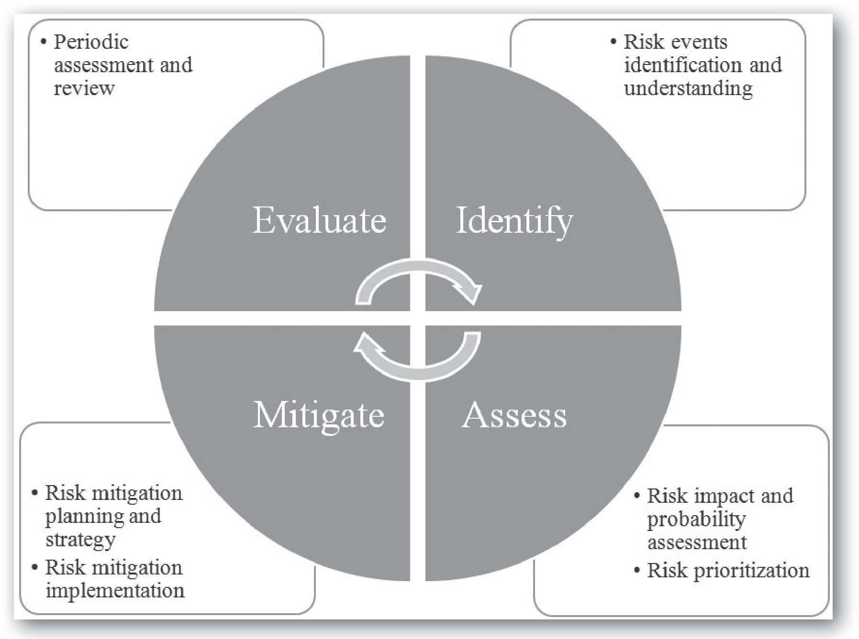
Social Media Risk Management Framework

Slide 23
Social Media Risk Management Framework
Risk identification: Identify potential social media risks such as hacking, information leaks, phishing, and impersonation.
Risk assessment: Determine the likelihood and impact of identified risks. Prioritize and rank risks based on probability and impact.
Risk mitigation: Implement strategies to manage, eliminate, or reduce identified risks. This may include physical, technical, and procedural measures.
Risk monitoring: Continuously monitor and assess risks to ensure that risk mitigation measures are effective and updated as needed.
Risk review: Regularly review and assess overall risk management strategy to ensure it is effective and up-to-date.

Slide 24
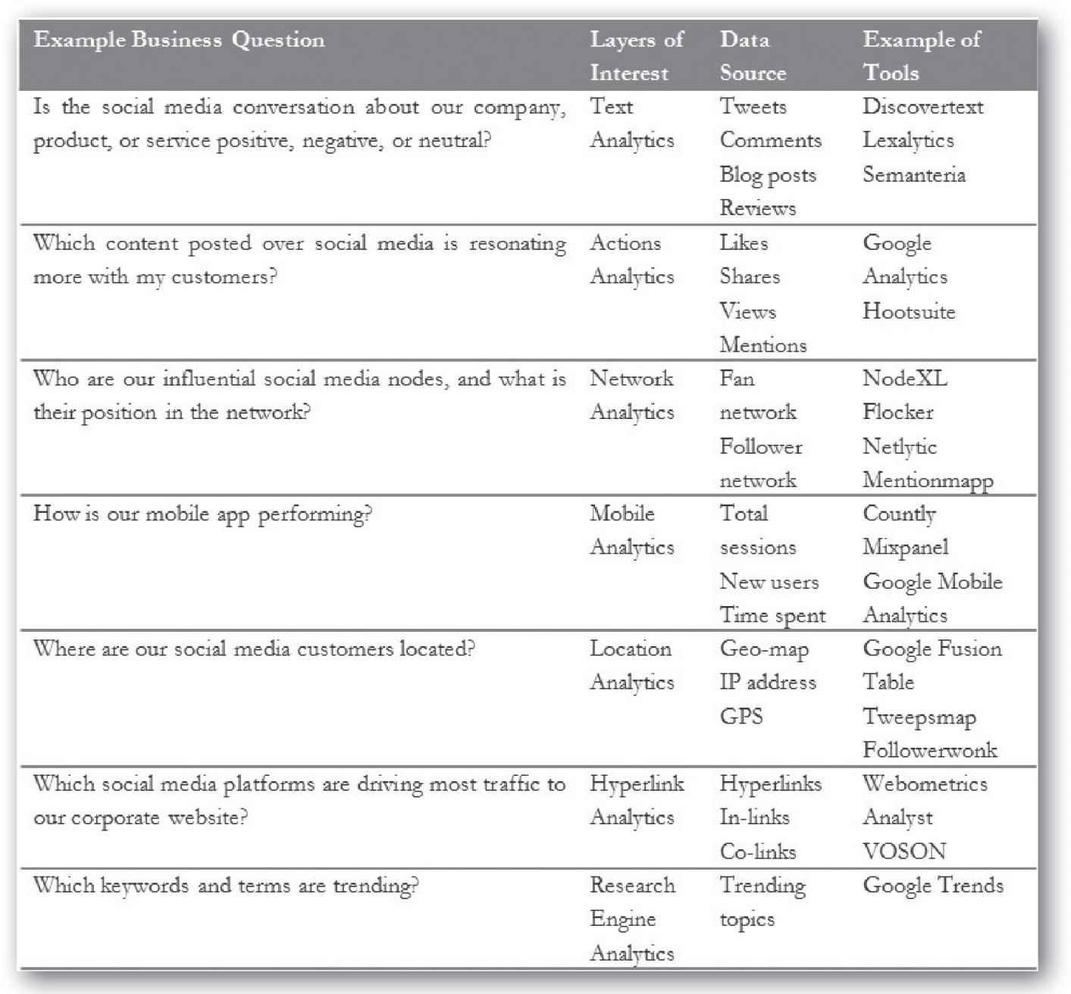
Aligning Analytics with Business Objectives

Slide 25
Questions
What is the goal of aligning social media analytics with business goals?
What is the purpose of social media strategy?
Explain the steps needed to formulate a social media strategy.
What are Social Media KPI?
What are some common social media risks?
Explain the four steps in social media risk management.

